Slide 1
To Design And Implement a Smartphone Based Dynamic Fall Detection System
Supervised by:
A.H.M Ashfak Habib
Assitant Professor, Department of CSE,CUET
Presented by :
A S M Nazrul islam
1204021

Slide 2
Contents
Introduction
Problem statement
Background
Aim & Objectives of the proposed system
Methodology
Conclusion

Slide 3
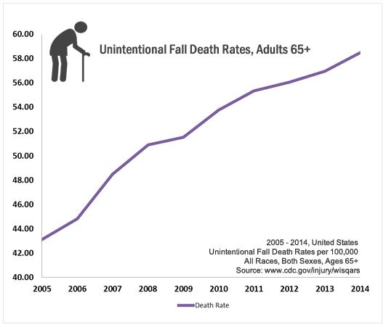
introduction
Fall-Second cause of death
Prone- children - pregnant women - old adults
Fall detection system(FDS)
Evolution of FDS

Slide 4
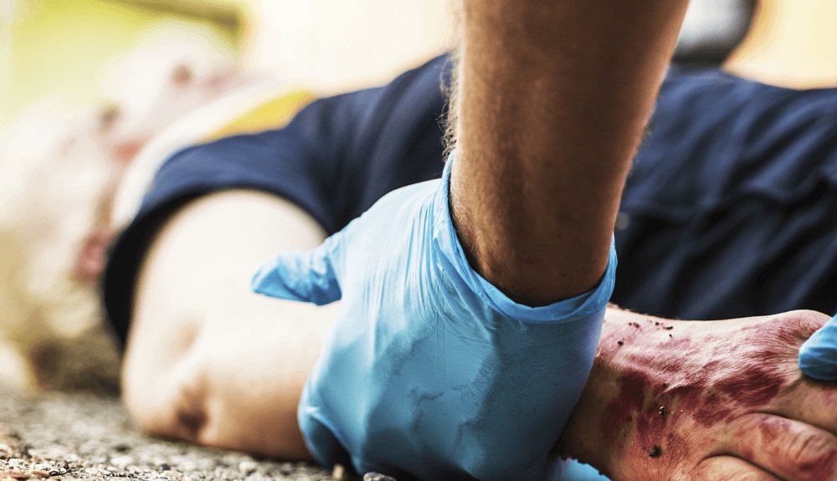
Problem statement
Present techniques detect fall considering smartphone in a fixed position.
Prevailing systems have an unbalanced co relation between false positivity and false negativity.

Slide 5
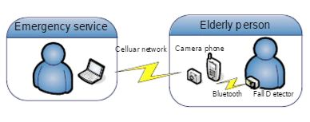
Background
First fall detection system was first introduced by Hormann in the early 1970s [1].
Hansen et al. [2] used the SP camera for the first time in 2005 for fall detection.
Technique: they used an external sensor based device to collect the sensor data and then passed these data via Bluetooth to a SP to analyze and if user don’t correspond to the system call, a photo is taken and send to a central server accompanied with previous data.
Limitations:
Have to wear the external device.
Bluetooth connection works for a small range.
Much more prone to false negativity due to depending on only accelerometer.

Slide 6
Background(continued)
Fudickar et al. [3] worked with threshold based fall detection.
Technique: the authors after getting the accelerometer values, based upon the threshold value detected fall.
Limitations:
The impact of fall is detected by checking time duration. But, in a slow fall, this technique won't work.

Slide 7
objectives
To design and implement a novel smartphone-based fall detection technique that uses multiple numbers of inbuilt smartphone sensors.
To make the technique dynamic so that it can automatically detect the position of the smartphone and select the appropriate threshold values accordingly.
To make the technique false alarm exempt by fusing multiple sensor’s value, so that it can avert the limitations of the previous works.
To make the technique robust and efficient by placing instant communication right after the occurrence of fall. Hence, resulting in restoring life.

Slide 8
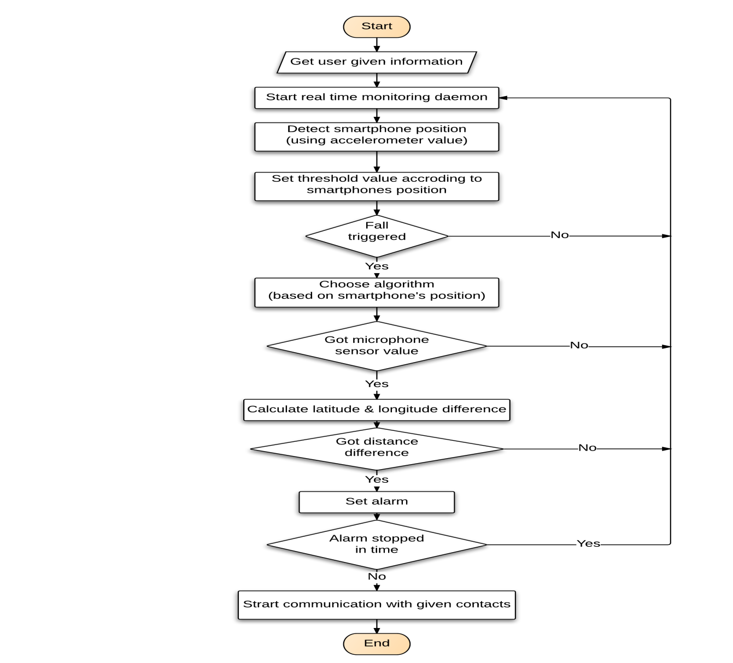
methodology
The methodology of this system can be divided into two parts:
Detecting fall procedures
Confirming fall procedures

Slide 9
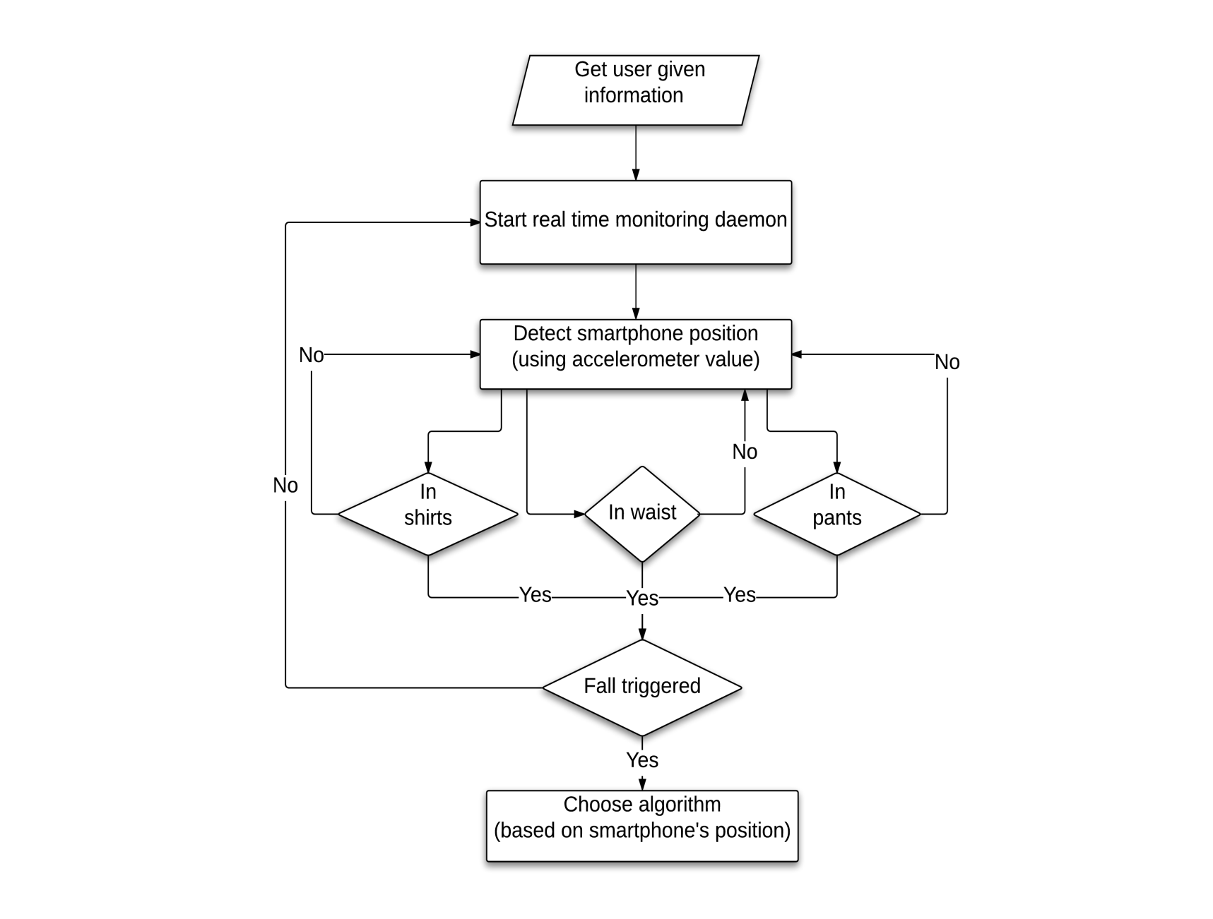

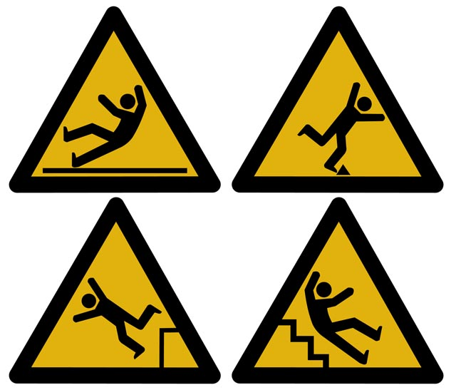
Methodology(continued)
1. Detecting fall procedures:
Get user data
Monitoring acceleration value
Detect smartphone position
Choose algorithm

Slide 10
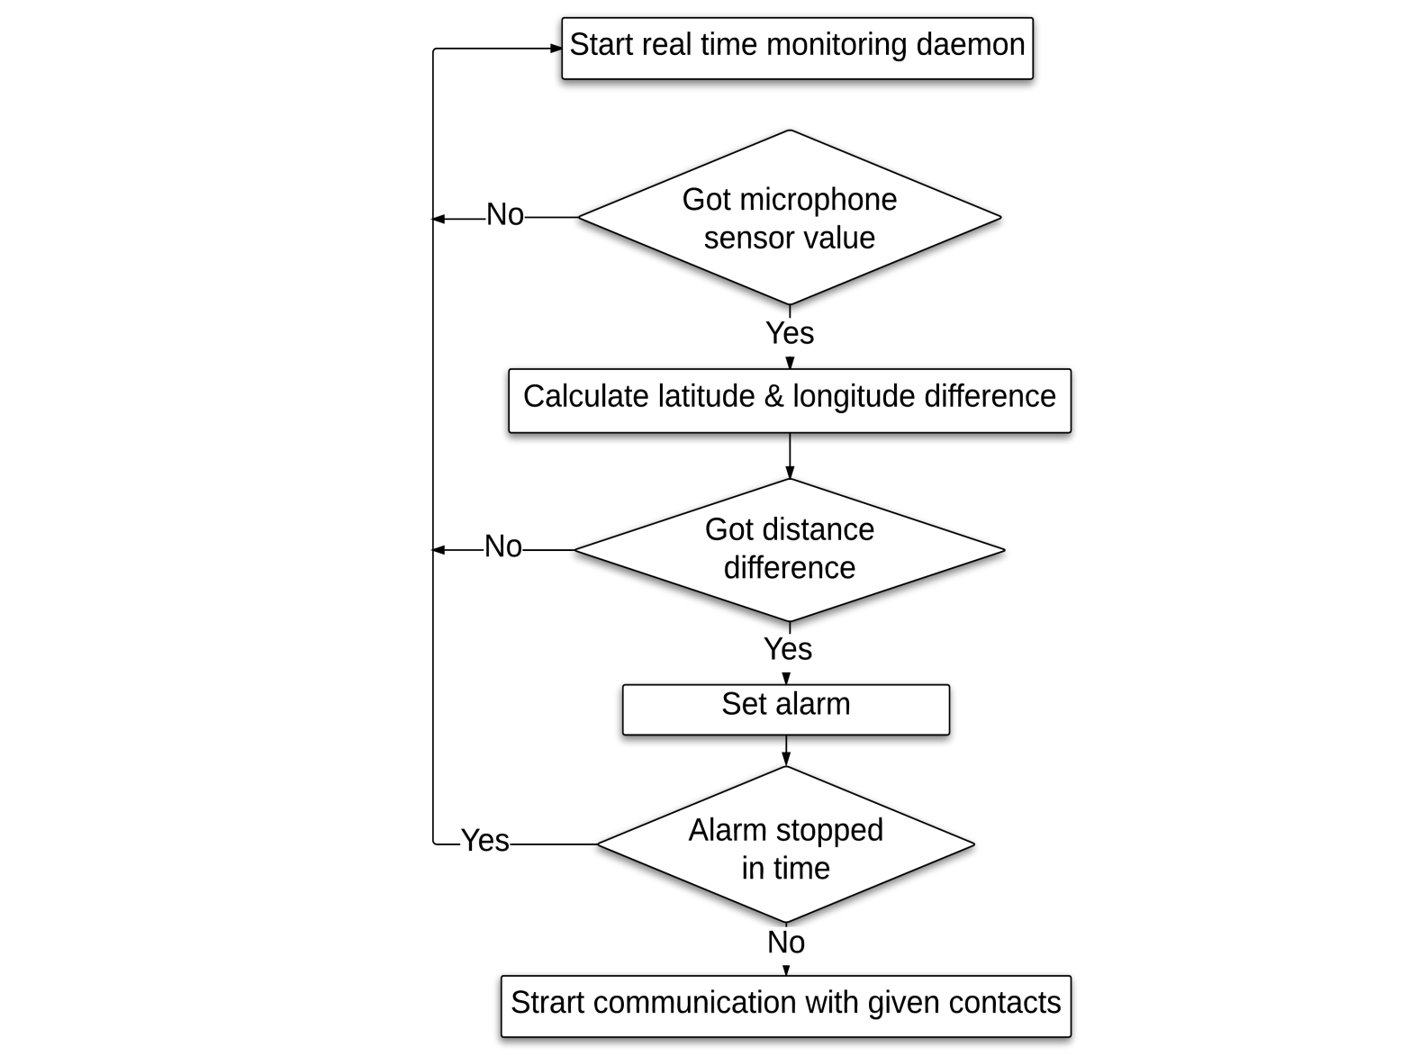

Methodology(continued)
2. Confirming fall procedures
Check microphone sensor value
Check position difference
Check alarm condition
Start communication

Slide 11
conclusion
Due to adverse effects in social, physical, psychological and economical aspects, falls have been an attractive issue.
The proposed fall detection system will detect fall dynamically in respect of any location and position.
Sensor fusion technique will results in more accurate estimation of falls.
So, the outcome of this project is a robust and reliable fall detection system, that will detect fall in respect of any location and position.

Slide 12
References
[1] Hormann,W.Kommunikationstechnologie im Dienst amMenschen. In HAUSNOTRUFSYSTEME Kommunikationstechnologie imDienst am Menschen; Heilscher,W., Ed.; Wirtschaftsverlag NW: Bremerhaven, Germany, 1980. (In German)
[2] Hansen, T.R.; Eklund, J.M.; Sprinkle, J.; Bajcsy, R.; Sastry, S. “Using smart sensors and a camera phone to detect and verify the fall of elderly persons”, In Proceedings of the European Medicine, Biology and Engineering Conference, Prague, Czech Republic, 20–25 November 2005.
[3] Fudickar, S.; Lindemann, A.; Schnor, B. Threshold-Based Fall Detection on Smart Phones. In Proceedings of the 7th International Conference on Health Informatics (HEALTHINF’2014), Angers, France, 3–6 March 2014.

Slide 13
Thank you

